Slide 1

CSVision A tool for data science
Yang Ong STATS418, Spring 2025

Slide 2
Introduction
There is a lot of data on the internet, much of it is in the form of unstructured text – such as job descriptions, product reviews, and personal reflections.
Recent advancements in LLMs and NLP methods have made it easier than ever to draw insights from this kind of data.
This app utilizes the power of LLMs, offering users a simple way to transform their unstructured text data into custom numerical variables at scale, enabling quantitative analysis.

Slide 3



How it works
Unstructured Text in CSVs
Numerical Variables
Insights

Slide 4
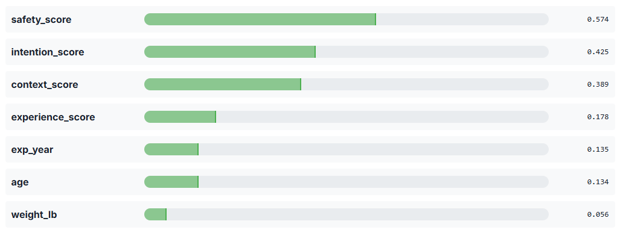
Example
Research Question: For people that have psychedelic experiences, what are the factors that are most correlated with positive outcomes?
Data Source: Erowid Experience Vaults, 570 personal reflections from 1996 to 2024, essay format.
Average # of words per entry: 1328
Distilled into Summaries:
Average # of words per entry: 425
Distilled to Numerical Variables:
Experience
Safety/Environmental Control
Context
Intention
Integration
Outcome
Notes:
Notes:
Large model performed much faster
Large model was more accurate, hallucinated less
Large model was able to detect more nuances between variables
According to the larger model, safety was the predictor most correlated with a positive outcome

Slide 5
Other Use Cases
Job Matching: Finding roles that align with your personal strengths
Workflow:
Scrape job descriptions across industries
Use CSVision to assess the level of specific skills required (e.g: Leadership, Collaboration, Data Analysis, Customer Service), rating each from 1-5. E.g:
Product Manager: Leadership (4), Collaboration (5), Data Analysis (4), Customer Service (2)
Data Scientist: Leadership (2), Collaboration (3), Data Analysis (5), Customer Service (1)
Analyze correlations and insights:
Which skills are most valued (and rewarded) across roles?
Which areas should you invest in improving?
Which jobs best match your unique skill profile?

